Slide 1
ICS 141 – Programming With Objects
Lecture 4 – Robert Jahn
Based on the slides of Dr. Daniel Liang

Slide 2
Schedule
Announcements/Reminders 6:00 – 6:05
Review Session 6:05 – 6:20
Quiz #3 6:20 – 6:40
2D Arrays 6:40 – 7:00
ND Arrays 7:00 – 7:10
Exercise 4(a) + Break 7:10 – 7:25
Classes and Objects 7:25 – 8:00
Exercise 4(b) 8:00 – 8:10
Midterm Guide 8:10 – 8:20
Assignment #4 8:20 – 8:25

Slide 3
Passing Arrays to Methods
public static void printArray(int[] array) {
for (int i = 0; i < array.length; i++) {
System.out.print(array[i] + " ");
}
}
Invoke the method
int[] list = {3, 1, 2, 6, 4, 2};
printArray(list);

Slide 4
Classes

Slide 5
Classes/Objects, 8.1
To this point, you have developed the skill to solve problems using the concepts of the first 6 chapters. We will be changing our focus to Object-Oriented-Programming (OOP). With OOP, we will be able to develop programs on a larger scale while still maintaining enough simplicity to reason about our programs effectively.
In these slides, we’ll review how to define classes, create objects, and manipulate objects.

Slide 6
Some Terms, 8.2
Class
A template or blue-print for representing some specifics about a given object.
Object
An instance of a class. Used to represent an actual real-world object.
State
The state (data fields) of a given object.
Behavior
The behavior (methods) of a given object.

Slide 7
Classes
Classes are constructs that define objects of the same type. A Java class uses variables to define data fields and methods to define behaviors. Additionally, a class provides a special type of method, known as constructors, which are invoked to construct objects from the class.

Slide 8
Classes

Slide 9
UML Class Diagram

Slide 10
Constructors
Circle() {
}
Circle(double newRadius) {
radius = newRadius;
}
Constructors are a special kind of methods that are invoked to construct objects.

Slide 11
Constructors, cont.
A constructor with no parameters is referred to as a no-arg constructor.
· Constructors must have the same name as the class itself.
· Constructors do not have a return type—not even void.
· Constructors are invoked using the new operator when an object is created. Constructors play the role of initializing objects.

Slide 12
Creating Objects Using Constructors
new ClassName();
Example:
new Circle();
new Circle(5.0);

Slide 13
Default Constructor
A class may be defined without constructors. In this case, a no-arg constructor with an empty body is implicitly declared in the class. This constructor, called a default constructor, is provided automatically only if no constructors are explicitly defined in the class.

Slide 14
Declaring Object Reference Variables
To reference an object, assign the object to a reference variable.
To declare a reference variable, use the syntax:
ClassName objectRefVar;
Example:
Circle myCircle;

Slide 15
Declaring/Creating Objects in a Single Step
ClassName objectRefVar = new ClassName();
Example:
Circle myCircle = new Circle();
Assign object reference
Create an object

Slide 16
Accessing Object’s Members
Referencing the object’s data:
objectRefVar.data
e.g., myCircle.radius
Invoking the object’s method:
objectRefVar.methodName(arguments)
e.g., myCircle.getArea()

Slide 17
Trace Code
animation
Declare myCircle
Circle myCircle = new Circle(5.0);
SCircle yourCircle = new Circle();
yourCircle.radius = 100;
myCircle
no value

Slide 18
Trace Code, cont.
animation
Circle myCircle = new Circle(5.0);
Circle yourCircle = new Circle();
yourCircle.radius = 100;
myCircle
no value
Create a circle

Slide 19
Trace Code, cont.
animation
Circle myCircle = new Circle(5.0);
Circle yourCircle = new Circle();
yourCircle.radius = 100;
myCircle
reference value
Assign object reference to myCircle

Slide 20
Trace Code, cont.
animation
Circle myCircle = new Circle(5.0);
Circle yourCircle = new Circle();
yourCircle.radius = 100;
myCircle
reference value
yourCircle
no value
Declare yourCircle

Slide 21
Trace Code, cont.
animation
Circle myCircle = new Circle(5.0);
Circle yourCircle = new Circle();
yourCircle.radius = 100;
myCircle
reference value
yourCircle
no value
Create a new Circle object

Slide 22
Trace Code, cont.
animation
Circle myCircle = new Circle(5.0);
Circle yourCircle = new Circle();
yourCircle.radius = 100;
myCircle
reference value
yourCircle
reference value
Assign object reference to yourCircle

Slide 23
Trace Code, cont.
animation
Circle myCircle = new Circle(5.0);
Circle yourCircle = new Circle();
yourCircle.radius = 100;
myCircle
reference value
yourCircle
reference value
Change radius in yourCircle

Slide 24
Reference Data Fields
The data fields can be of reference types. For example, the following Student class contains a data field name of the String type.
public class Student {
String name; // name has default value null
int age; // age has default value 0
boolean isScienceMajor; // isScienceMajor has default value false
char gender; // c has default value '\u0000'
}

Slide 25
The null Value
If a data field of a reference type does not reference any object, the data field holds a special literal value, null.

Slide 26
Example
Java assigns no default value to a local variable inside a method.
public class Test {
public static void main(String[] args) {
int x; // x has no default value
String y; // y has no default value
System.out.println("x is " + x);
System.out.println("y is " + y);
}
}
Compilation error: variables not initialized

Slide 27
Visibility Modifiers and Accessor/Mutator Methods
By default, the class, variable, or method can be accessed by any class in the same package.
public
The class, data, or method is visible to any class in any package.
private
The data or methods can be accessed only by the declaring class.
The get and set methods are used to read and modify private properties.

Slide 28
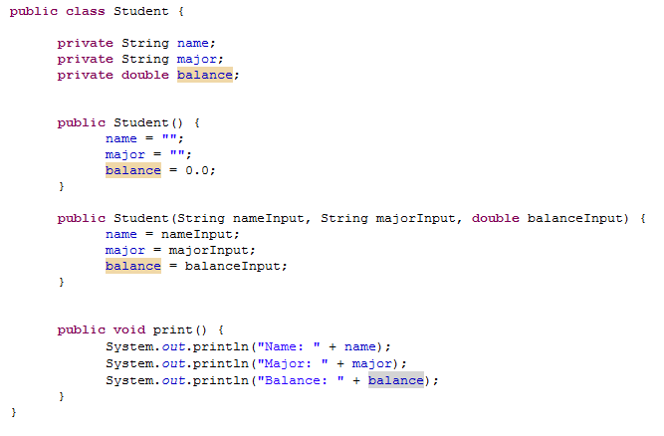
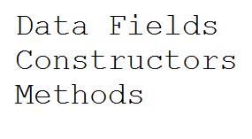
Example of a Class, 8.3

Slide 29
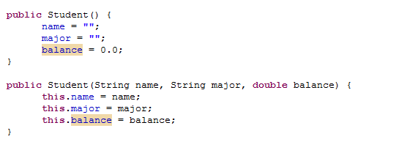
Constructors, 8.4
Constructors are a special kind of methods that are invoked to construct objects.

Slide 30
Creating Objects Using Constructors, 8.4
Student s1 = new Student("Bob", "Computer Science", 1000.0);
Student s2 = new Student();

Slide 31
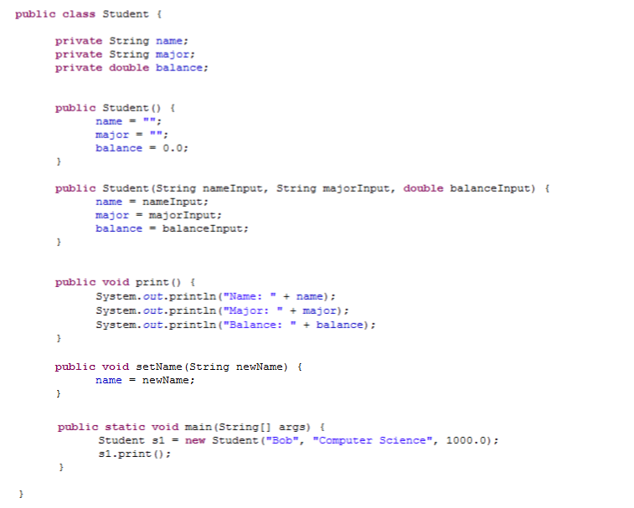
Creating an Instance of a Class, 8.4
OUTPUT

Slide 32

Creating an Instance of a Class, 8.4
OUTPUT

Slide 33
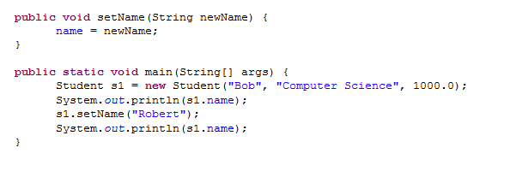

Using the dot-operator to access objects, 8.5
OUTPUT

Slide 34
Exercise 4b

